Slide 1
Mathematical Principles for Data Science
Path to Checkpoint: Workshop 4
Link to Materials: http://bit.ly/2kwTZiy
Link to Attendance: http://bit.ly/2m5meW5
PIN: 174253

Slide 2


Slide 3


Slide 4
Probability/Stats
The math behind the magic

Slide 5
So what is Probability? What about Stats?
Probability: The extent to which an event is likely to occur
What is the probability that matrix multiplication is on the midterm?
Statistics: Analyzing data to make inferences about a population from those in a representative sample.
Of the past 15 midterms, 14 of them have involved matrix multiplication
Statistics can help us estimate probability!

Slide 6
So why do we care about probability?
Word
Recommendation
Weather
Prediction
Financial
Forecasting/Modeling

Slide 7
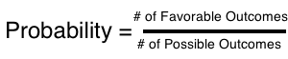
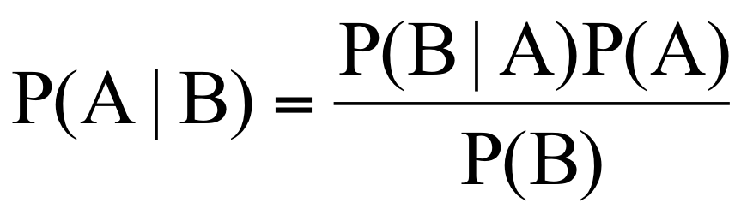
Probability: In-Depth
Basic Probability
Conditional Probability
Likelihood a particular event will occur
out of the possible ones that can occur
Probability an event will occur given another event has.
Can be calculated using Bayes’ Theorem
Independence & Mutual Exclusivity
Two events are independent if A occurring doesn’t impact the likelihood of B occurring
Two events are mutually exclusive if A occurring means B can’t occur

Slide 8
CODING TIME!

Slide 9
Linear Algebra

Slide 10
So what is Linear Algebra?
Linear algebra is the study of linear sets of equations and their transformation properties.
--Wolfram
Ax=b
Basic Concepts:
Scalar
Vector
Matrix
Tensor
Hyperplane
Point
1D
2D
3D

Slide 11
Converting Data into Matrices
 | Number of Dogs | mg of Caffeine | Happiness
Person 1 | 5 | 100 | 10
Person 2 | 6 | 120 | 5
Person 3 | 7 | 140 | 0
5 | 100 | 10
6 | 120 | 5
7 | 140 | 0

Slide 12
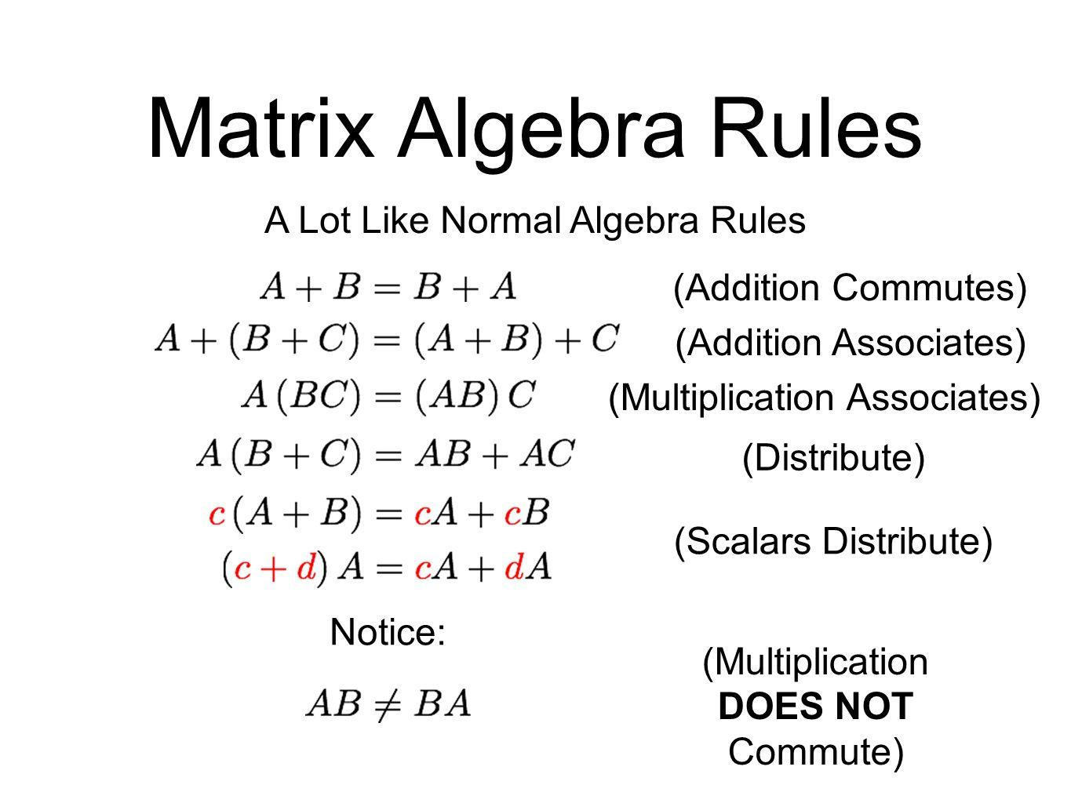
Matrix Operations
Addition/Subtraction:
Same as regular algebra
Multiplication:
Dot product
Element-wise product
Outer Product
Division:
Matrices cannot be divided

Slide 13
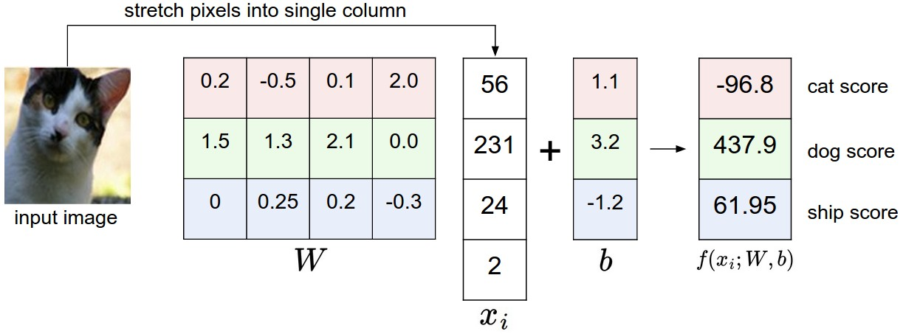
Ax = b use case
Notes:
Reorder?

Slide 14
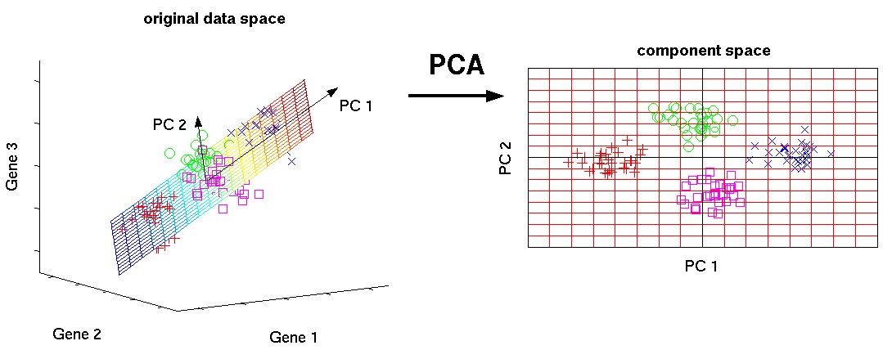
Eigenvalues and Eigenvectors
Ax=λx
Eigenvectors (x): vectors that don’t change direction when multiplied by a matrix A
Eigenvalues (λ): scaling value for length of the eigenvector

Slide 15
Optimization
How can we best make predictions?

Slide 16
Goal of ML
Maximize Performance
Minimize Error
Minimize Cost Function

Slide 17
What does it mean to be “accurate”?
Regression
Classification
On average, how close is our prediction to the actual value of the event?
On average, how often do we accurately classify a given event?

Slide 18

Regression
Error Definition:
Average Distance between each predicted point and actual point
Linear
Non-Linear
Error Metric
Optimization:
Linear Regression? Cubic Regression? Quadratic Regression?

Slide 19
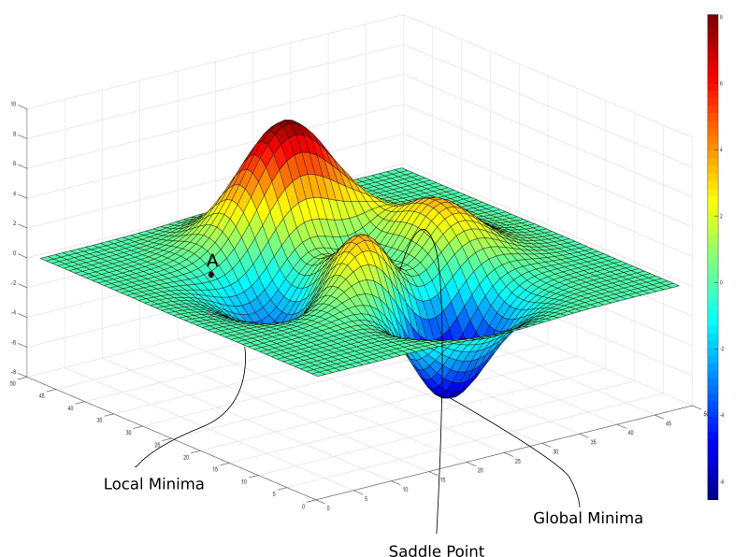
Gradient Descent
Optimizing in high-dimensional space
Steps
Initialize
Run model
Compute error
Adjust
Output ML model
Cost Function (Hard)
Cost Function (Easy)
Easy to find local minimum (yay derivatives)
Notes:
//Add a 2D visual and talk about 2d vs 3d //add definition of gradient
Random Initialization

Slide 20
Classification
Error Definition:
Incorrectly classifying the event based on its features. 2 main types. Shown by Confusion Matrix
Classification: Right or Wrong
True Pos (TP)
True Neg (TN)
False Pos (FP)
False Neg (FN)
TP
FP
FN
TN

Slide 21



Classification
Error Definition:
Incorrectly classifying the event based on its features. 2 main types. Shown by Confusion Matrix
Classification: Right or Wrong
True Pos (TP)
True Neg (TN)
False Pos (FP)
False Neg (FN)
FP
(Type 1)
TP
FN
(Type 2)
TN
Notes:
//Animate these icons //Add labels

Slide 22
CODING TIME!

Slide 23
THANKS!
Any questions?
Seriously please ask questions or I’m just gonna stand here awkwardly and look at you guys until it becomes unbearably uncomfortable for all parties involved

